Slide 1
Online Book Order
Bolatbekkyzy Gulbina

Slide 2
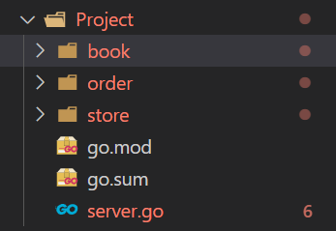
GRPC. My components.
Here, we have main components of the project. They are: book, order and store, where have books and orders (added by client).

Slide 3
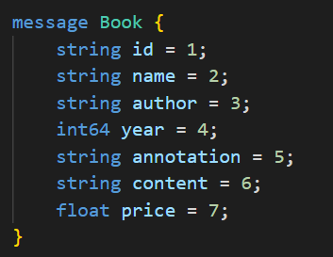
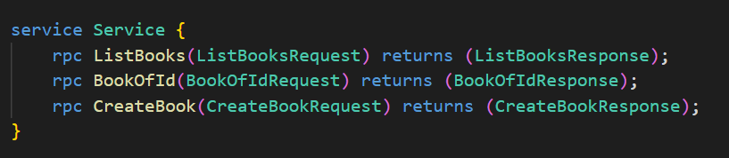
BOOK
Book has id(unique) number (we can search by id), name, author, year, annotation, content and price.
We can get list of books, find book by id, create book.

Slide 4
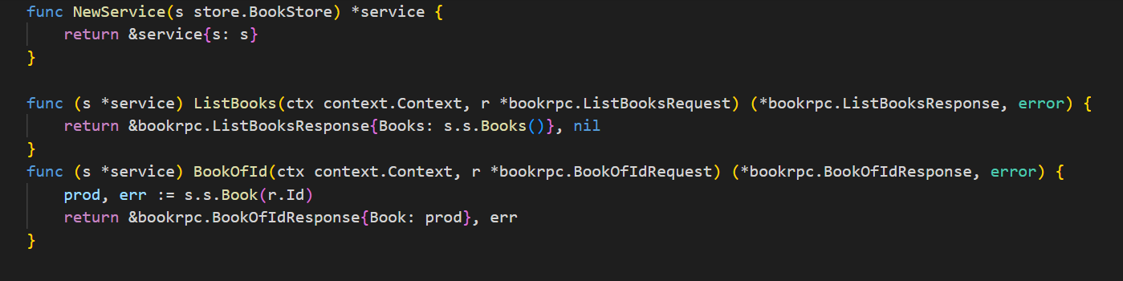
Book service
Here, we create a new service to get contact with store(data base). In the store we have books store. So, we write the books that returned our function ListBooks into the store.
In the BookOfId function we want to get book by id.

Slide 5
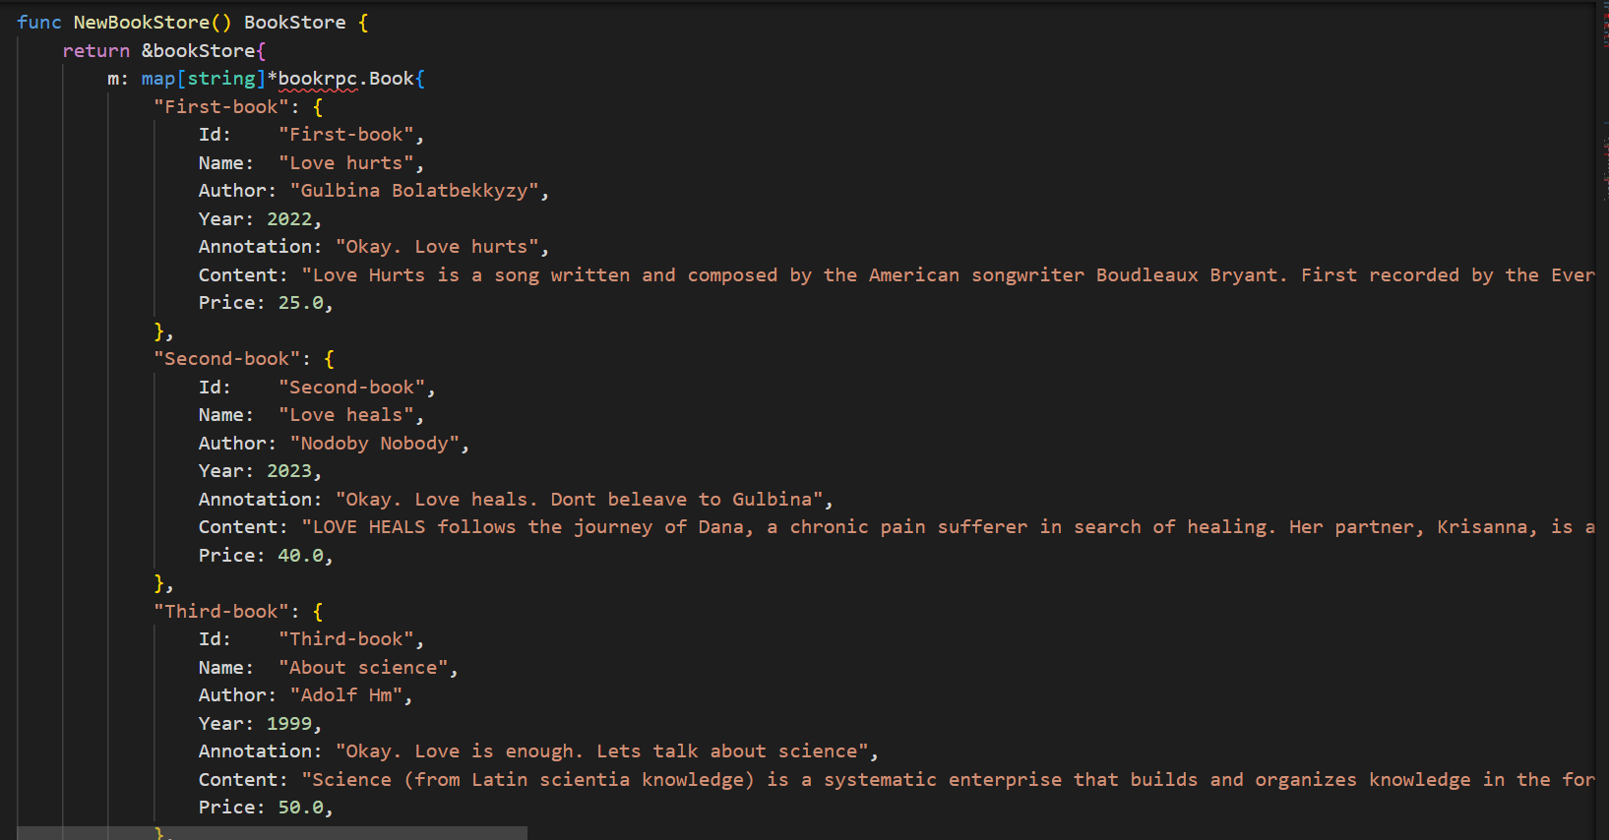
Book store
Create a book store with some elements. We have a map, the key is id of the book, and the element is an object book.

Slide 6
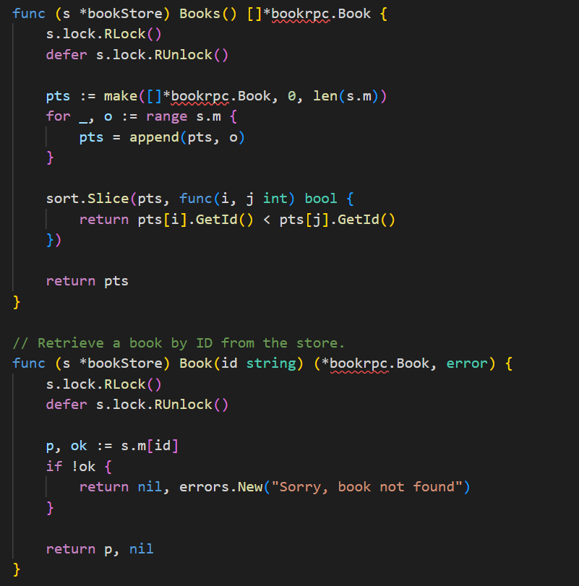
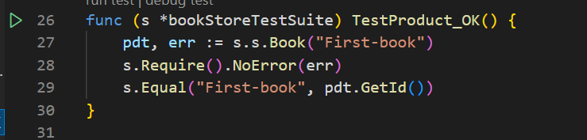
Main function
Here some logic part of our project. It’s when we want to get
sorted books by ascending order. The function Book gets the
Book by id.
Here some test for getting book by id. And test was correct.

Slide 7
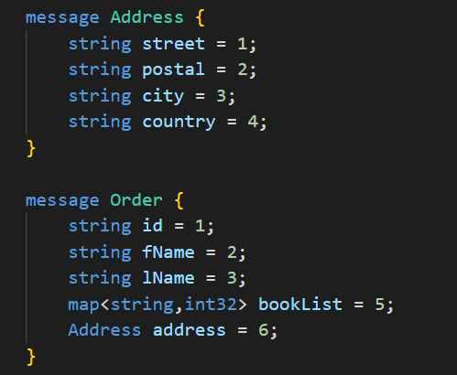
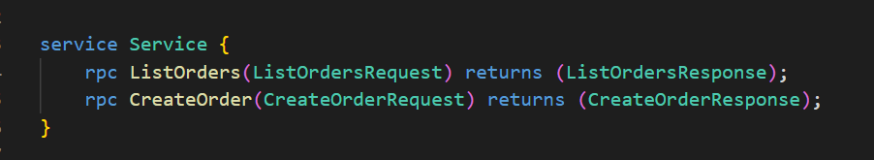
Order
Order has id, first name,
last name, booklist and address.
We can get list of orders and
create new order.

Slide 8
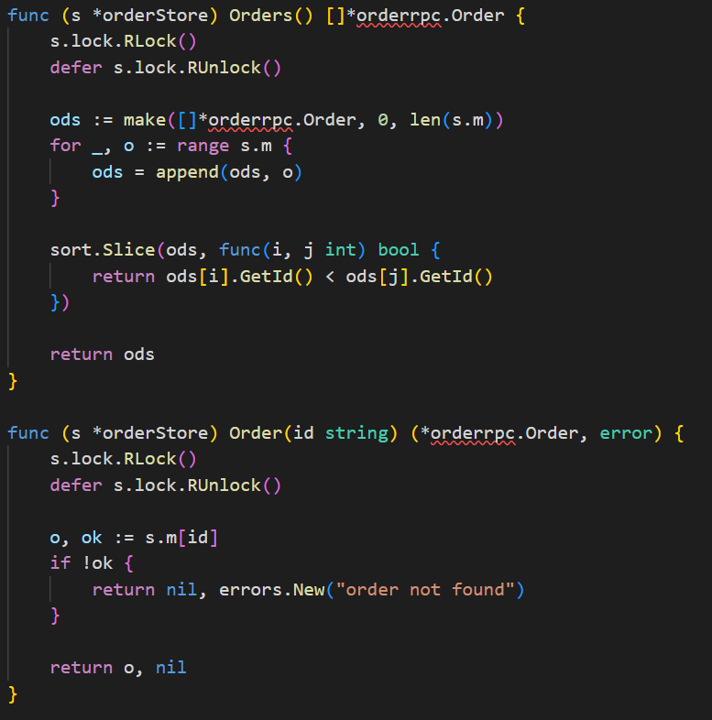
Getting orders and order by id.

Slide 9
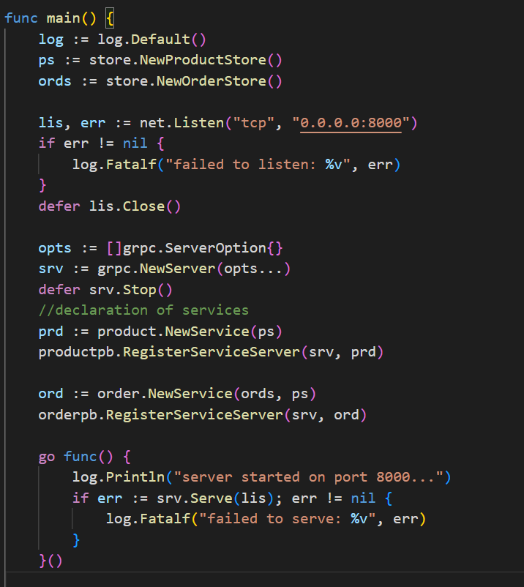
Server
Server is connected to the port :8000.

